Slide 1


Anti-Depression Chatbot
Impacting and Improving lives through AI

Slide 2
Contents
Mission
The Team
The Problem Statement
The Solution
How It Works
The Architecture Diagram
General Flowchart for Chatbot
Impact Matrix
Value Proposition
Impact of our solution
Performance Strategy in the Industry
Agility of Product
Revenue Model
Graphical Representation
Future Scope of Idea
Appendix
Thank You Slide

Slide 3

Mission: Revolutionising mental health space with technology through innovation

Slide 4


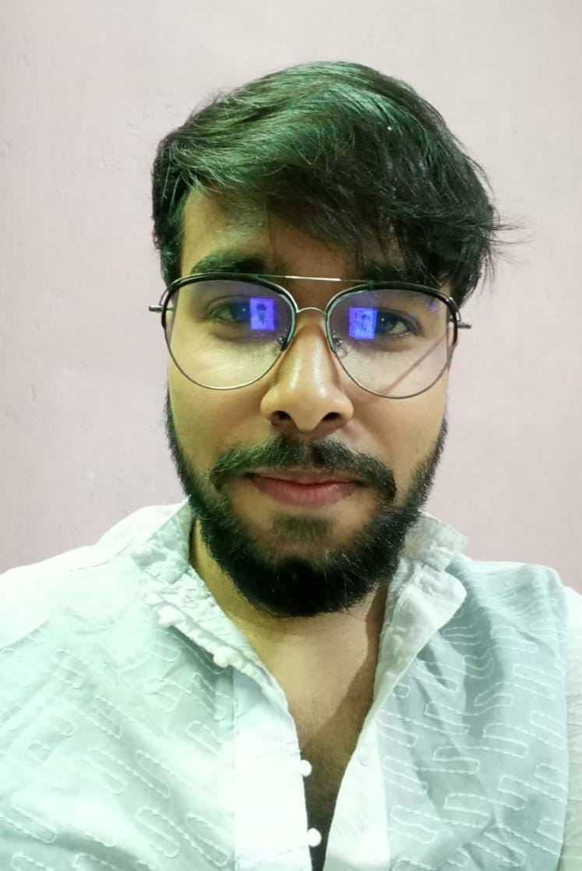
The team - TDM
Being college undergrads with lots of expectations and responsibilities, we experienced depression and mental health issues such as anxiety and stress on a first hand basis which really drove us towards innovating a solution for the problem
Debargha Saha
Manojit Roy
Tuhin Subhra Das
College Senior - Final Year Engineering (B.Tech in ECE)
Engineer, Avid Tech lover and a Motivated designer & developer
College Senior - Final Year Engineering (B.Tech in ECE)
College Senior - Final Year Engineering (B.Tech in ECE)
A problem solver and technology geek who loves to leverage technology to solve problems and issues and build products
A budding engineer, problem solver, passionate about ML, and AI, having a strong interest in projects that require both conceptual and analytical thinking, and always eager to learn more.

Slide 5
The Problem
Mental Health and Depression are a rising cause of concern in the young generations of the Indian population today in the age group of 18-25, which leads to poor quality of life in the youngsters making them go through an extremely tough and uncomfortable phase of life, some leading to severe implications as well. 1 in 7 children is facing mental health issues every day in India. Many of the youngsters face mental disorders like depression, anxiety, ADHD, Schizophrenia, and a lot more. Unfortunately, less than 1% of them get medical help, as topics like mental illness aren’t talked openly about.
Depression rates by each year (2016 - 2020)
60%
42%
30%
21%
2017 | 2018 | 2019 | 2020

Slide 6

The solution
We plan to solve this problem through a conversational AI Chatbot. The chatbot we have planned can converse with the user in a well disposed manner and comprehend the sentiments and feelings of the user exactly. The chatbot utilizes AI calculations to do as such and afterward closes to the state of the client. If the client is recognized with any sort of dysfunctional behavior or misery then the chatbot attempts to give them the home solutions for adapt up to their psychological and enthusiastic state. On account of significant issues, for example, suicidal thoughts then the chatbot will sent info about counselling helpline, and appointment portal links to the user(and notice is additionally sent to guardian of the client.<- Not implemented yet).

Slide 7
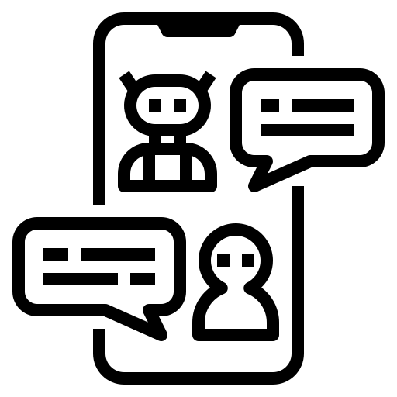




How it works
Step 1
Step 2
Step 3
Step 4
The user responds to the chatbot and gradually the conversation gets carries on
Through deep user conversations and simple questionnaires the mental status of the user is tracked down
Our chat assistant gets initiated manually by the user through a tap or click on the deployed platform
The chatbot initiates the conversation with a welcoming message, or any time
with a simple “Hi”!

Slide 8
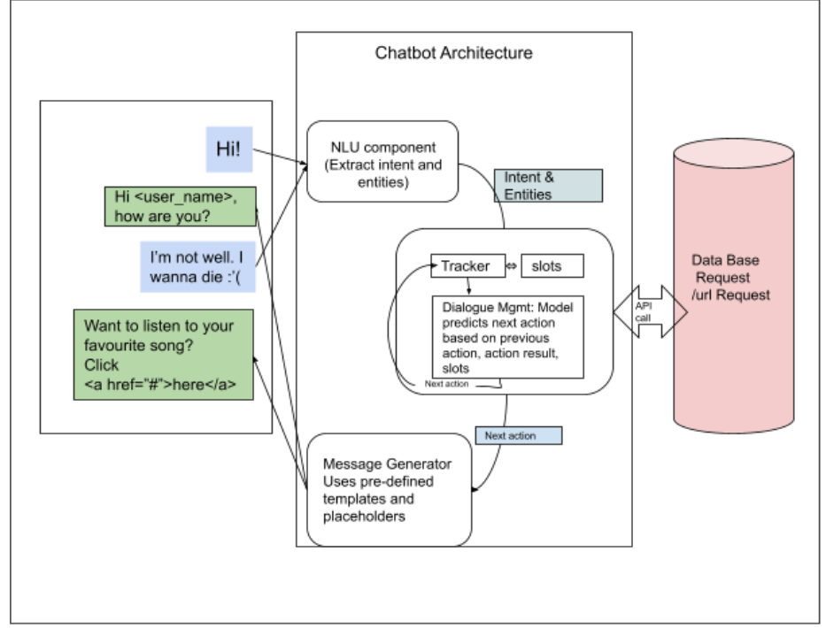
Architecture Diagram

Slide 9
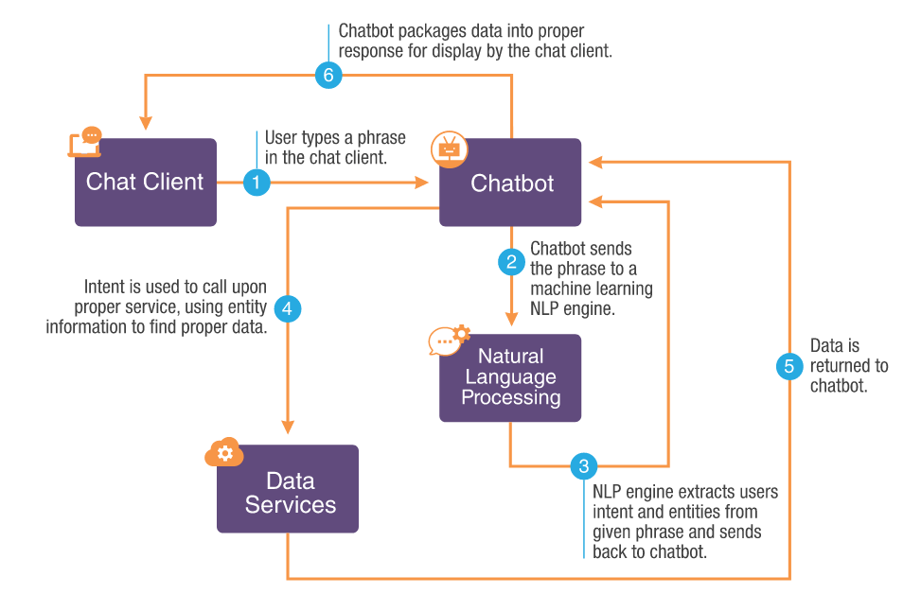
General Flowchart for chatbot

Slide 10
Solution Impact and Key Metrics for Judgement

Slide 11
Impact Metrics used to analyze the Effect of the Solution of the Problem
User Feedback and Reviews
User Engagement
Analyzing the Metrics
Judging the effect our solution and improving it for the better
Comprehension Capabilities
Speed
Functionality

Slide 12
Value Proposition of the Idea
The sole value offered by our Idea to the users of our product mainly focuses on providing services and offering virtual help in the form of counselling, entertainment, interactive response, guidance and support and best mental practices to take a step forward towards solving mental and emotional problems in the lives of our users hence an attempt towards improving lifestyle quality and pushing them towards a healthy lifestyle. We strive to provide exactly what our users wanted through conducting user surveys and providing more by going an extra mile after thoroughly contemplating the feedbacks and surveys.
Our product indeed causes an innovation to the industry, shifting and parting ways from the traditional ways of dealing with mental health problems through specialized clinics and chambers for psychiatry. Since there are no industry leaders in the Mental Health Space, particularly in India, we foresee a huge opportunity to manifest what we envision and an opportunity to create disruptive innovation to disrupt the traditional and ineffective ways to diagnose and detect mental health problems in youngsters in the country. We leverage technology and integrate it into our solution to achieve the best out of our product to revolutionize the sector itself and create an impact.

Slide 13
Impact of our Solution
The Impact generated by our solution is very vital and important. The two most important impacts made are drawn below :-
Individual Impact
Social Impact
It can largely help in revolutionizing the mental health space in our medical industry. It can serve as a bridge for the gaps present currently in issues related to mental health. A general upliftment of the mental health and mind state of individuals as well as the society as a whole
The user feels a mental support who is always with them to listen and hear out to what the user has to say. The chatbot makes the user feel special and important and celebrates the smallest of the achievements and successes of the user. The chatbot positively impacts the mind of the user by directly engaging with them as much as possible and having open-ended conversations

Slide 14
How our solution will become a game changer in the industry?
The solution we propose is one of it’s kind, with very little to no practical implementation on field by any other product at all, considering in focus the Indian market. The impact and disruption how it will cause in its specified category is mentioned through the points below :-
Disrupting the already prevalent traditional ways of inefficient and outdated diagnosing mechanisms for mental health problems which relies on the patient to open up inherently to their psychiatrists about their problems and is only possible if the patient speaks out about his/her problems which at times might feel forced, uncomfortable and submissive to external pressure from peers, family or mentors, as a result the patient might not open up at all. In our solution, the chat assistant acts as a supportive friend or close acquaintance and makes the patient feel comfortable and secure to open up to our assistant.
Proposing a new innovative way of problem diagnosis and early detection by leveraging technology which introduces a new way towards solving this problem at a large scale if implemented successfully, the innovative aspect of this idea - Using a virtual assistant to tackle mental health issue is something which has not yet been leveraged by any industry and this is what will prove to be our USP, if big giants start disrupting into our market soon.
Lack of big players of the industry in the mental health sector rules out the possibilities of competition and dominance already existing in the market, instead the small contributors who are trying to build something in the space can possibly help us better by providing us insights over their failed areas and opportunities missed by such small enterprises and their products.

Slide 15
Agility of Product
The product that we have developed leverages the digital technologies on a cloud based infrastructure where we run our workloads primarily in cloud with the whole application being built in small pieces of individual software components such as dialog nodes, entities, intents which allows enough room for further modifications and enhancements and being run on cloud infrastructure it also takes care of the scalability and maintenance if the load goes up in future.
One of the biggest aspects of agility is using big data and analytics to help fuel the decision making process which we have used in our solution as well along with Machine Learning.
The 5 Product Strategies to keep our product flexible to support Global Standardization
Advertising and Marketing Campaign
Global Consumer Research
Reverse Engineering & Innovation
Multilingual Chat Support
Go-to-Market Approach

Slide 16
Revenue model
Product (Chatbot)
Essential and Primary Services (Chatbot advices, suggestions, normal conversation, playing videos and fun activities)
All Services provided by the product (Chat Counseling, advices, guidance, health suggestions etc.)
Advanced features and personalized services (Counselling, support and healthcare suggestions, personal chat assistant through google account services)
Users can also go for direct subscription based on several subscription plans to access all the services of the product
Users can initially opt for services which are free and can continue to use the chatbot for absolutely free
The revenue model that we plan to use for our product or idea is a mixture of two models -
Freemium Model and Subscription Revenue Model
(Basic Account - Free)
Subscription Plan (yearly or monthly) - Paid
Upgradation
Premium Account - Paid (Different Plans)

Slide 17

Demonstration of Work till now
Representation, Principles and Future Scope

Slide 18
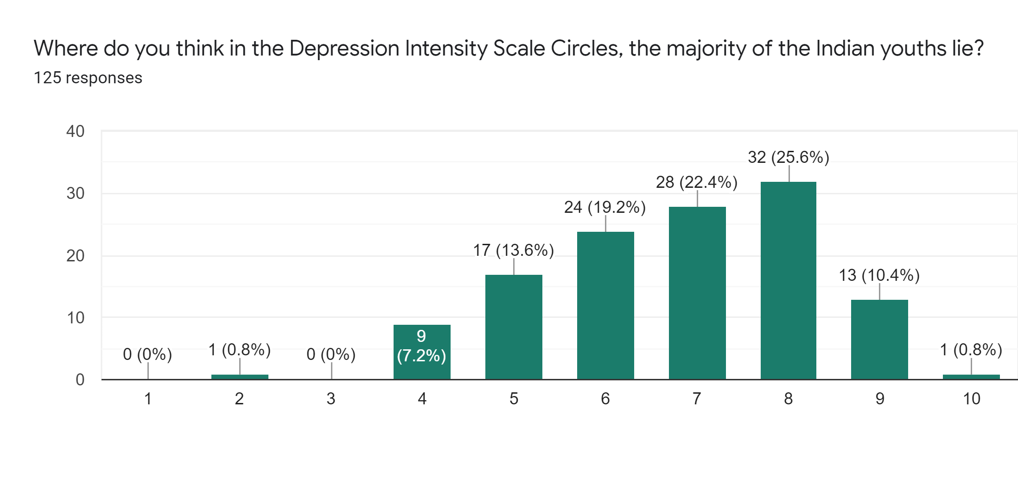
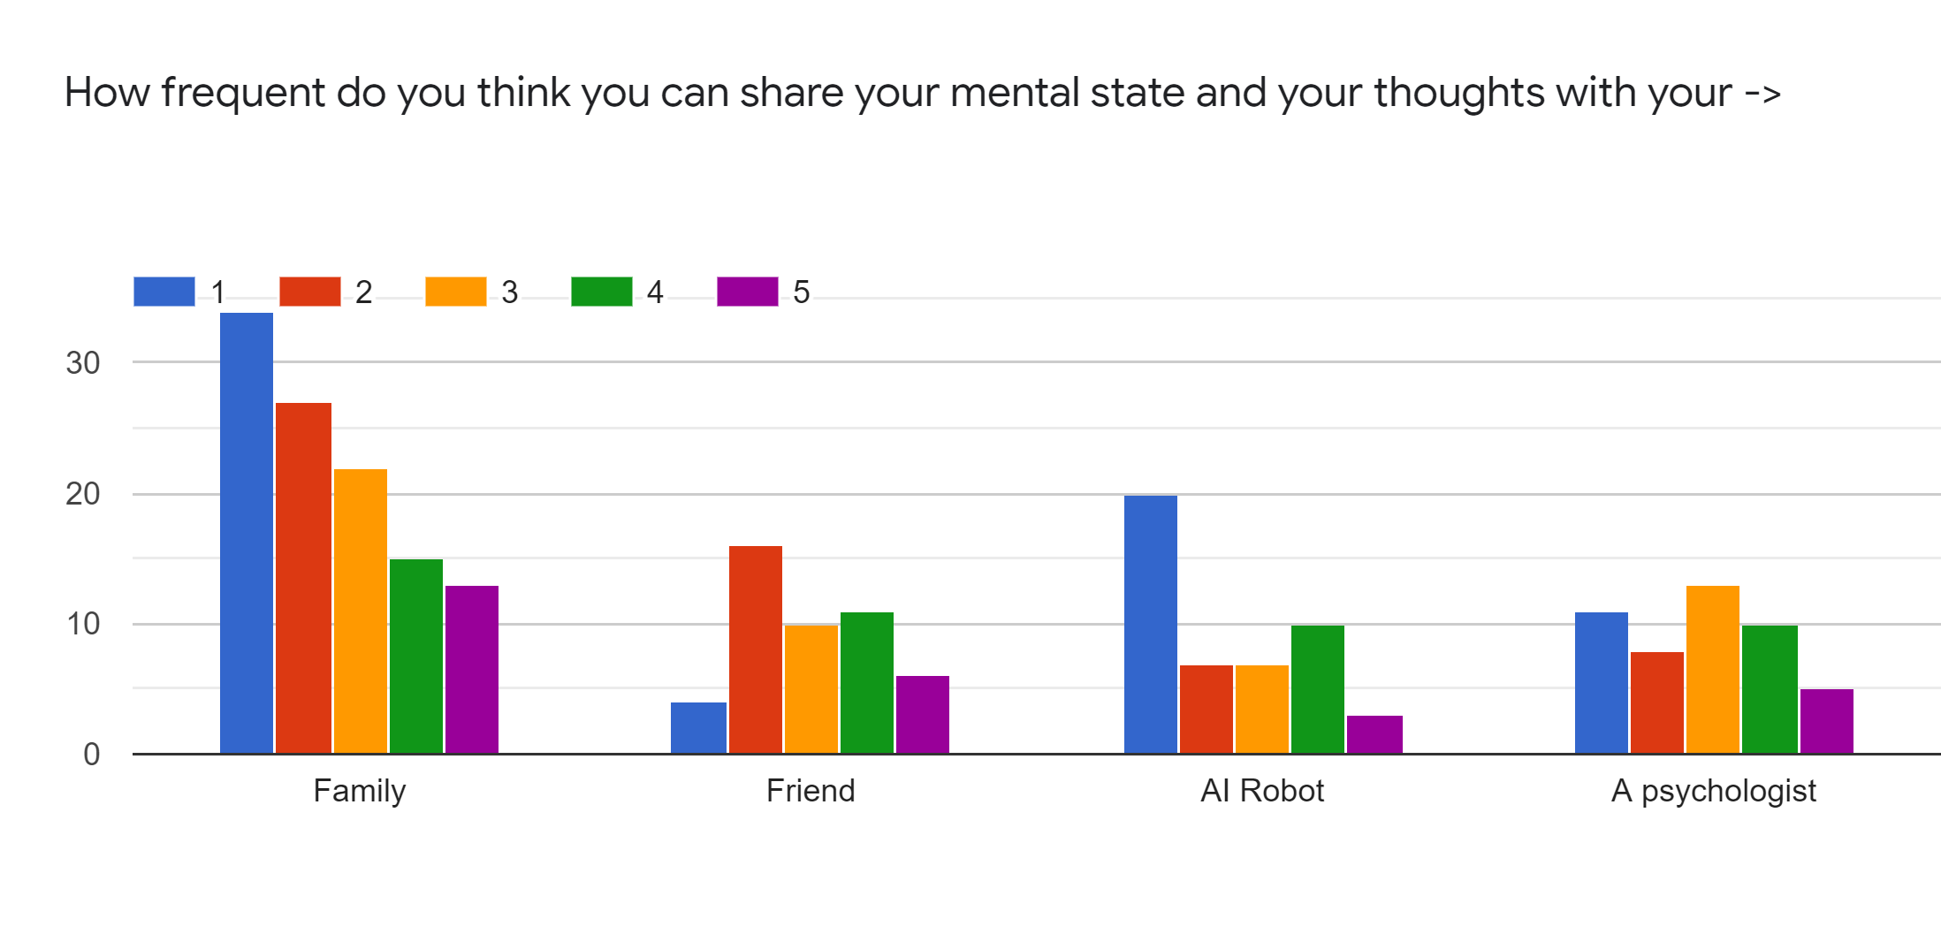
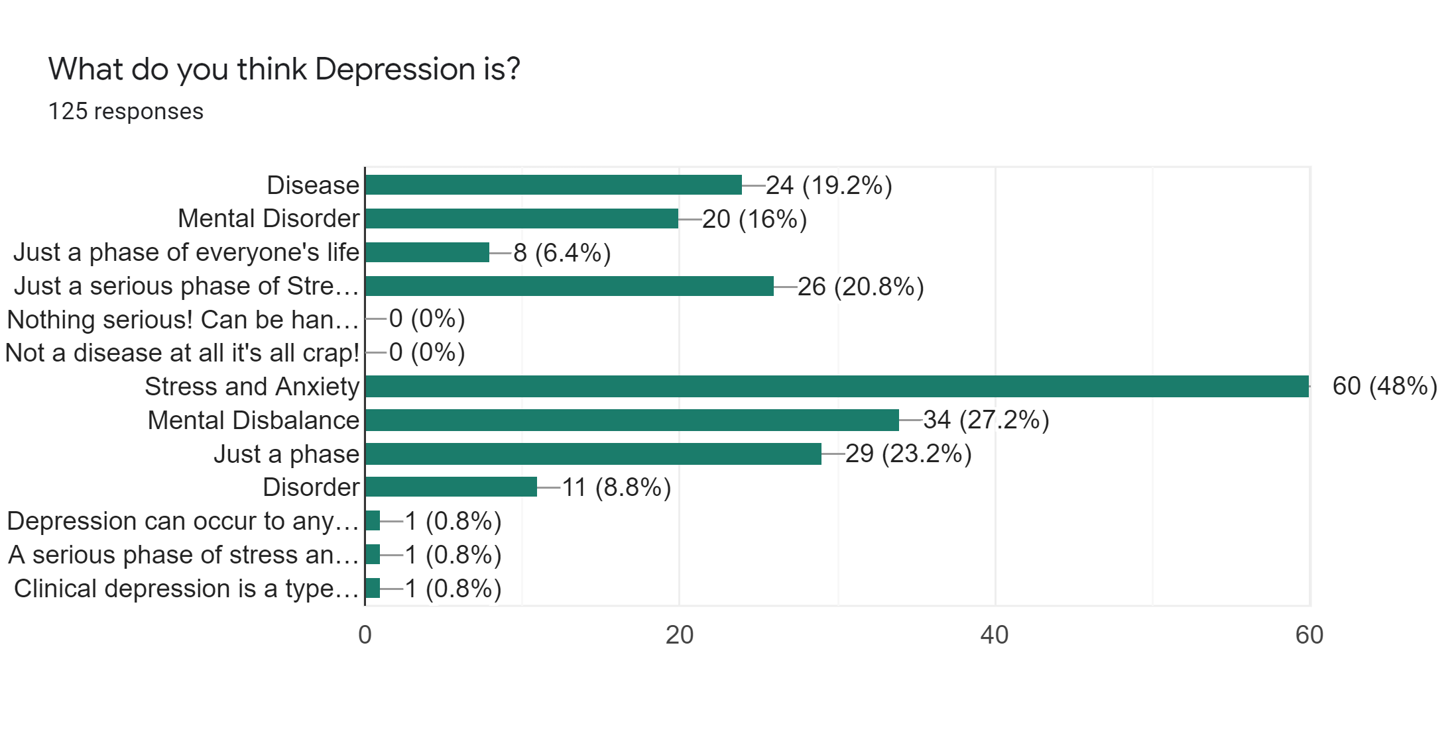
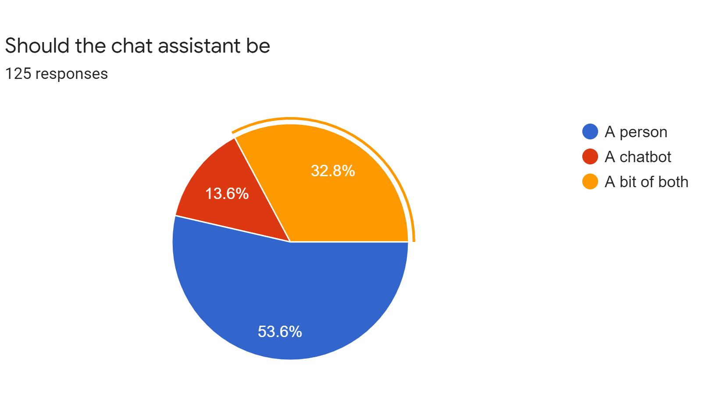
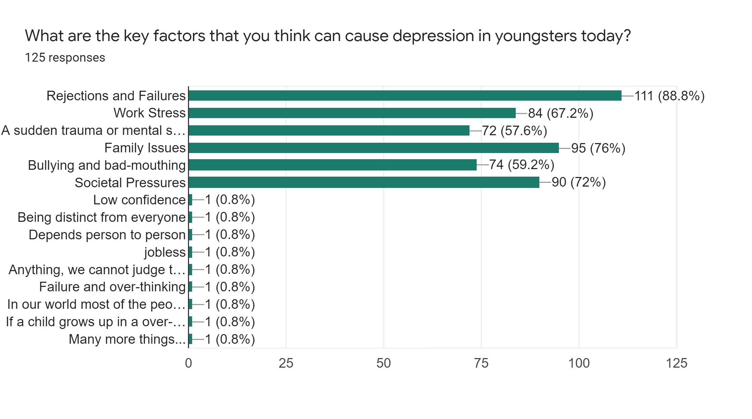
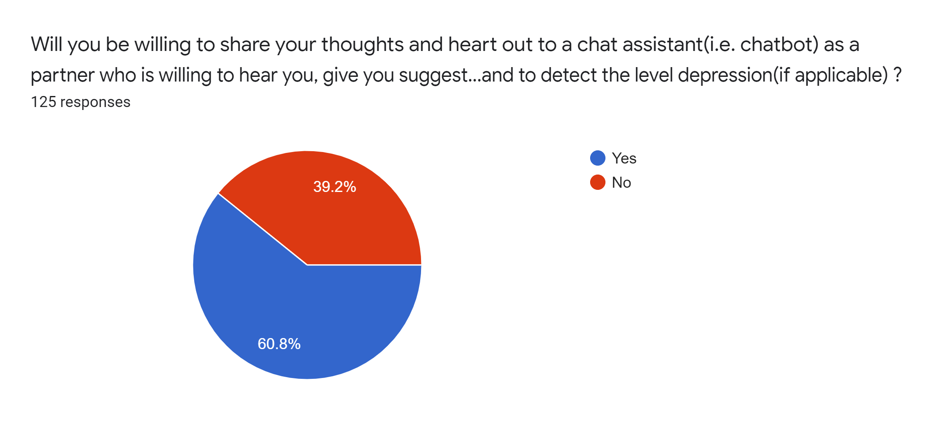
Graphical Representation
To understand our users and audiences better, we conducted a user-survey with curated set of questions related to Mental health, depression, chatbot usage, their daily activities, habits and behaviours to understand our audience better and take a peek into their thought processes and their expectations from the product we are building. The following graphs shows the responses of few of the questions from the survey form with the help of creative graphical representation.

Slide 19
Future Scope of the Idea
Vision : The sole vision of this Idea is to revolutionize the mental health sector and to impact the lives of people by helping them to the greatest extent to solve the mental health problems and depression and improve their quality of lives.
In future, we also plan to raise awareness and encourage the people to give the due important to Mental Health and acknowledge and face their problems, so that we can bring about more people suffering through the depressive phase and the mental disorders to speak up openly and fearlessly without any feeling of shame and to remove the perception of mental health disorders as a Taboo, through the use of collective insights and analysis drawn from the data to raise an alarm among the individuals.
Keeping in mind a noble cause and a sense of offering help, we do not plan to extensively commercialize on this idea making profits and revenue the sole factor to determine the sustainability and future of our product because we believe in the societal and individual importance of this idea covering a holistic approach to the problem itself.

Slide 20
PRODUCT DEMONSTRATION
IBM Assistant Preview (Chatbot) - https://bit.ly/noob-anti-depression-chatbot
GitHub Repo Link - https://github.com/Stark-developer01/HackFest_2022
YouTube Video Link - https://www.youtube.com/watch?v=Yw5ZACd0ARA

Slide 21
Appendix
For user queries, feedback and suggestions we have created a google form where our users can share their feedback as well -
User Response Survey post Chatbot Use - https://forms.gle/L9DacwyjrPdgxyZL9

Slide 22
THANK YOU

